Slide 1

Introduction
"Exploring Wireshark: A Network Packet Analysis Tool"
Notes:
In today's digital age, where our world is increasingly interconnected, understanding network communications has never been more crucial.

Slide 2
What is Wireshark?
Wireshark is a robust open-source network packet analysis tool used in IT and Cybersecurity to understand and manage network communications. effectively.
Purpose:
Network troubleshooting.
Performance optimization.
Protocol analysis.
Detecting and mitigating security threats.
Analyzing network traffic for signs of malicious activity.

Slide 3
Key Features
Packet Capturing
Protocol Analysis
Deep Inspection
Graphical Representation
Export and Import
Scripting Support
Community Support
Cross-Platform
Security Analysis

Slide 4
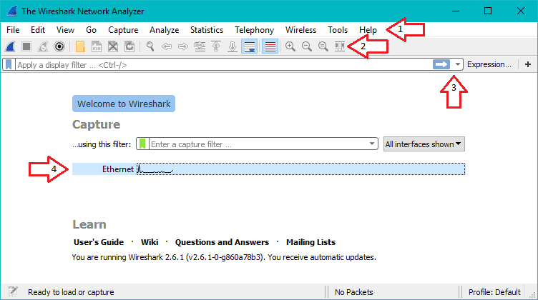
Wireshark User Interface (GUI) Overview
The Menu
The Main Toolbar
The Filter Toolbar
The Interface List

Slide 5
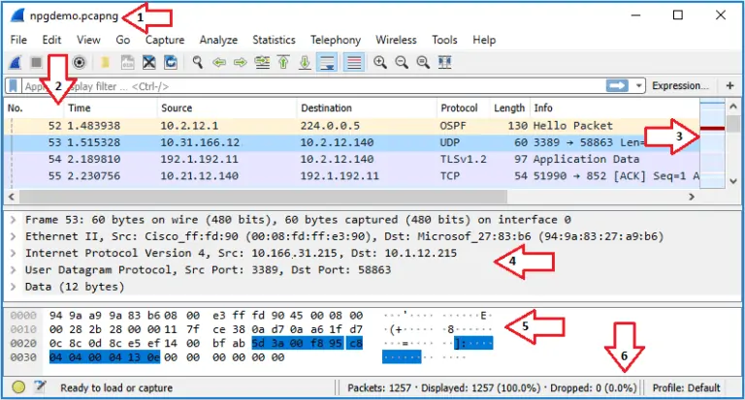
Wireshark Capture File
Title Bar
Packet List Pane
Intelligent Scrollbar
Packet Details Pane
Packet Bytes Pane
The Status bar
Notes:
Title Bar
This bar shows the name of the interface you’re capturing until you save your capture. Then it will show the name of the capture dump file. If you open a saved capture file its’ name will be displayed here.
Packet List Pane
Every line in this pane represents one packet. By default, the pane is broken up into columns like Number, Time, Source, Destination, Protocol and info. Each of which provides useful identification data for each packet and can be sorted to help you better dissect the data. You can remove, add, and reorder the columns to suit your needs. Selecting a packet will show more details in the Packet Details Pane and Packet Bytes Pane.
Scrollbar
To the right of the Packet List Pane is a colored bar called the Intelligent Scrollbar which is a mini-map of packets. Every line of the Intelligent Scrollbar is a raster line that represents a single packet. This list makes it easy to jump to packets based on colorization.
Packet Details Pane
This pane displays the packet’s different protocols and protocol fields. This is list is displayed as a tree that can be expanded to show even more detail.

Slide 6
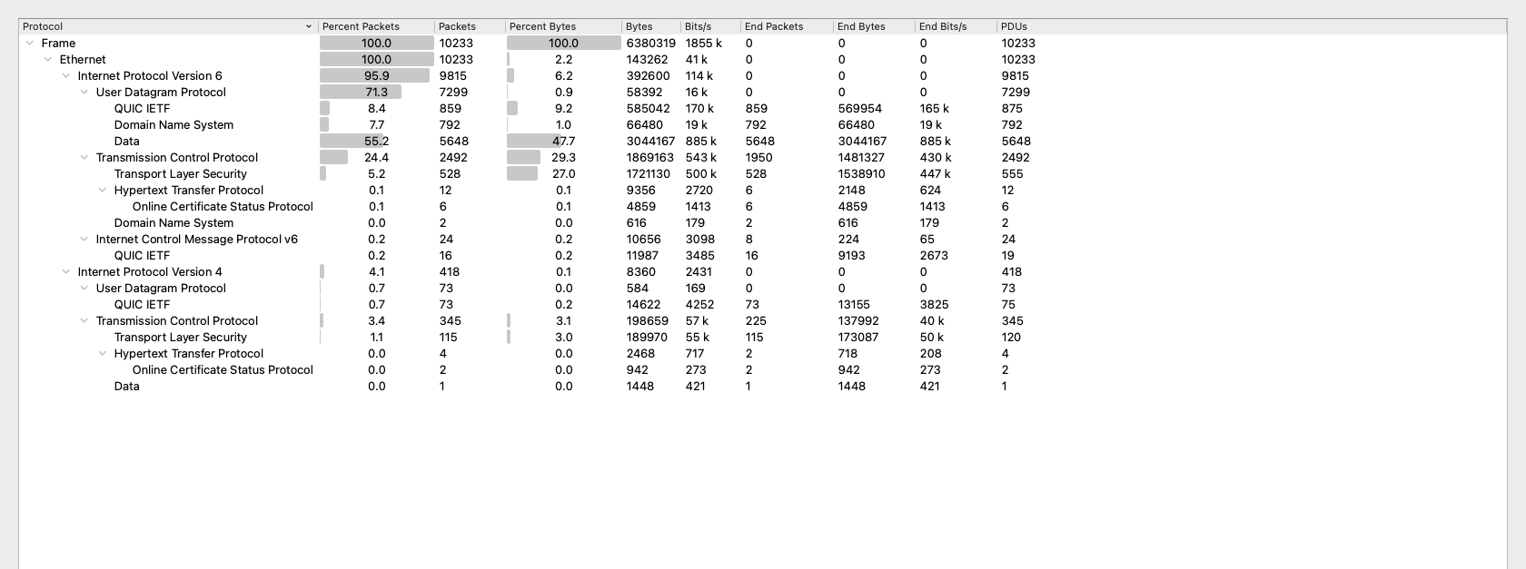
Analyzing Protocols
Wireshark excels at decoding and analyzing a wide range of network protocols like TCP,UDP,HTTP and Ping.
Notes:
Ethernet (Ethernet II):
Wireshark can capture Ethernet frames at the data link layer.
It displays information like source and destination MAC addresses, frame type, and frame size.
Internet Protocol (IP):
IP is responsible for addressing and routing packets across a network.
Wireshark provides details about IP versions (IPv4 or IPv6), source and destination IP addresses, Time-to-Live (TTL), and more.
Transmission Control Protocol (TCP):
TCP is a connection-oriented transport protocol.
Wireshark offers insights into TCP flags (e.g., SYN, ACK, FIN), sequence and acknowledgment numbers, window size, and more.
We can analyze TCP conversations and follow streams to reconstruct application-layer data.
User Datagram Protocol (UDP):
UDP is a connectionless transport protocol.
Wireshark displays source and destination port numbers, packet length, and payload data for UDP packets.
Hypertext Transfer Protocol (HTTP):
Wireshark can dissect HTTP traffic, allowing us to see HTTP requests and responses.
We can view URLs, status codes, headers, and even the content of web pages.
Domain Name System (DNS):
DNS packets can be analyzed to understand hostname resolution.
Wireshark shows DNS queries and responses, including domain names and associated IP addresses.

Slide 7
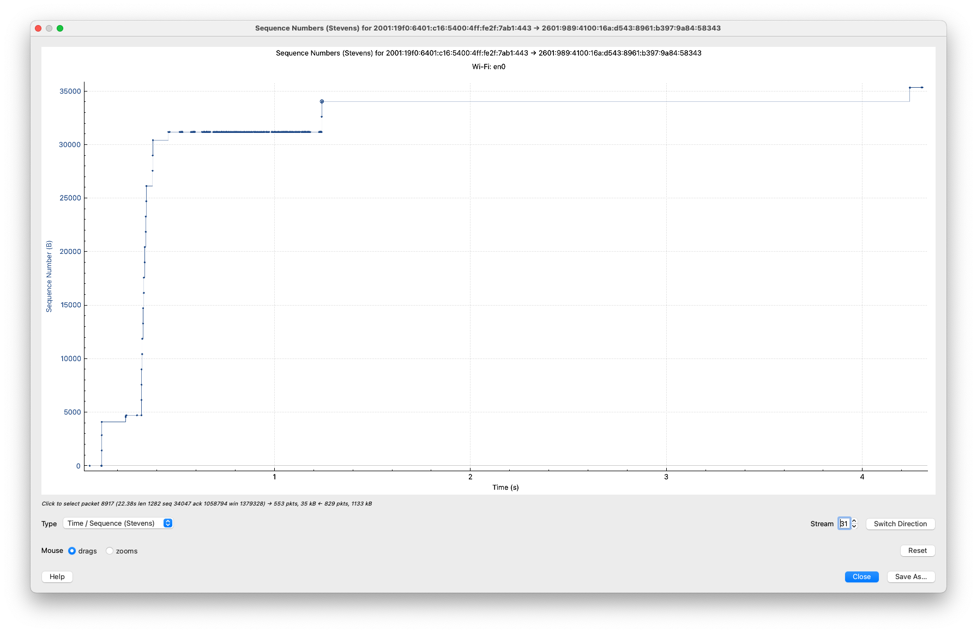
Congestion Graph
A congestion graph provides a visual representation of how TCP manages its congestion window size over time, helping to monitor and optimize network performance. It plays a vital role in diagnosing network congestion issues and ensuring efficient data transmission over TCP-based connections.
Notes:
Congestion Graph: The congestion graph is used to understand how TCP manages the flow of data between two communicating devices over a network, taking into account network conditions and congestion levels.

Slide 8
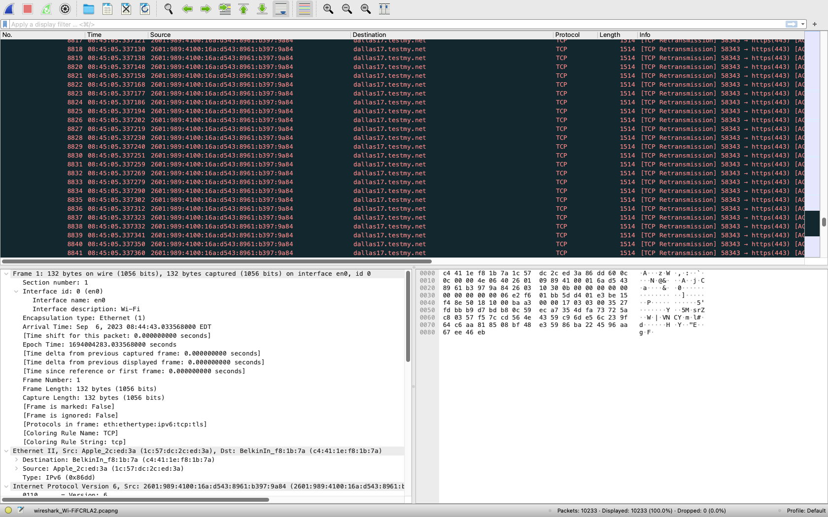
TCP Congestion Control
TCP congestion control is a fundamental mechanism for managing data flow and preventing network congestion. It involves various algorithms and strategies to ensure efficient and fair data transmission over TCP connections. Wireshark can capture TCP packets and provide insights into the flow control, window size adjustments, and other congestion control mechanisms in use.
Notes:
TCP congestion control test using Wireshark and testmy.net helps in understanding how well is the internet connection and the underlying TCP protocol are performing in terms of managing congestion and optimizing data transfer.
It also Analyze the captured packets in Wireshark to observe TCP congestion control mechanisms like window size adjustments, retransmissions, and congestion window variations.

Slide 9
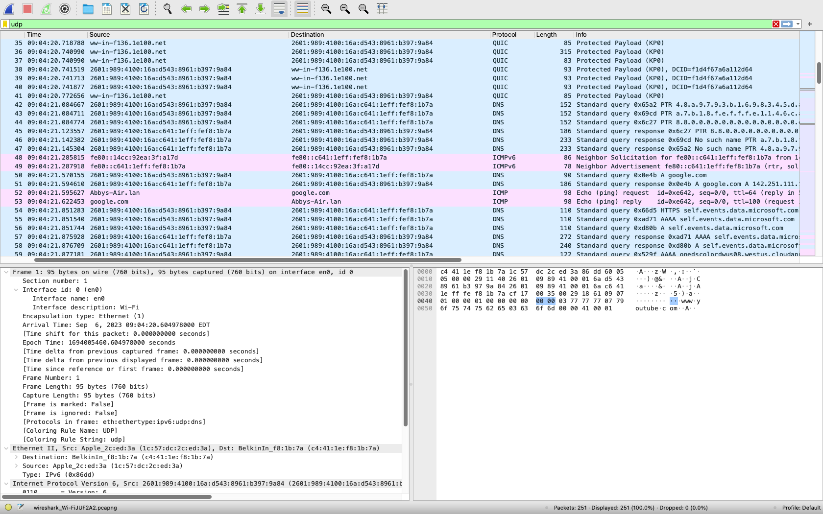
Ping Traces and Wireshark captures
Ping is a simple network diagnostic tool used to test the reachability of a host on an Internet Protocol (IP) network. It sends ICMP echo request packets to a target host and waits for an echo reply. Wireshark can capture these packets and display information about the round-trip time, packet loss, and other network statistics.
Notes:
Ping is a simple network diagnostic tool used to test the reachability of a host on an Internet Protocol (IP) network. It sends ICMP echo request packets to a target host and waits for an echo reply. Wireshark can capture these packets and display information about the round-trip time, packet loss, and other network statistics. To capture a ping packet, open a command prompt or terminal and use the "ping" command (e.g., ping www.example.com) then observe the ping packets captured in Wireshark.

Slide 10
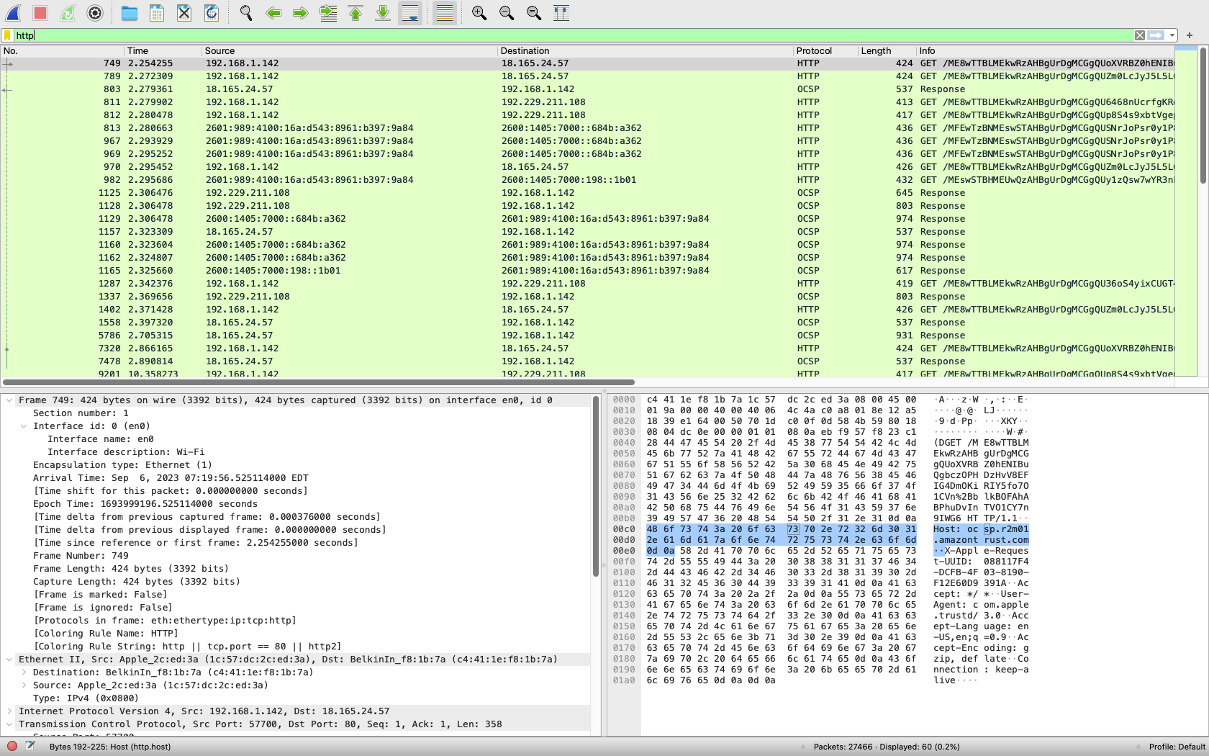
HTTP Capture
HTTP is the protocol used for transmitting web pages and other web resources on the Internet. When you access a website, your browser sends HTTP requests to the web server, and the server responds with HTTP responses containing the requested content.
Wireshark can capture and analyze these HTTP packets, which allows us to inspect headers, content, and response times.
Notes:
To capture HTTP traffic, open a web browser and visit a website (e.g., http://www.example.com).
Observe the HTTP packets captured in Wireshark.
The class type in this scenario is class "c". Class C is a type of IP address that is used for the small network. In this class, three octets are used to indent the network. This IP ranges between 192 to 223.

Slide 11
Conclusion
Wireshark can be a valuable tool for analyzing various types of network traffic, including Ping packets, HTTP communication, and TCP congestion control scenarios. It allows you to inspect packet details, understand network behavior, and diagnose network issues.
Ethical use of Wireshark and similar network tools means respecting privacy, being transparent, staying within the law, and handling data responsibly. Failure to do so can lead to legal problems and can harm your reputation.

Slide 12
References
https://www.wireshark.org/docs/wsug_html_chunked/index.html

